Slide 1
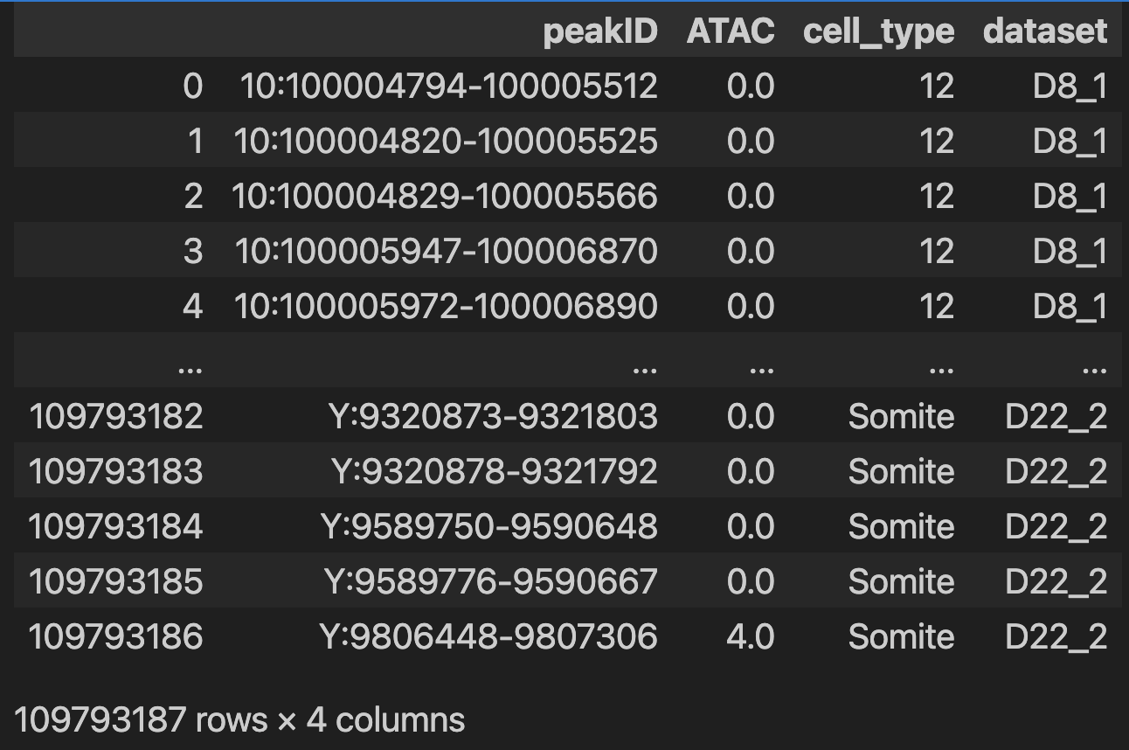
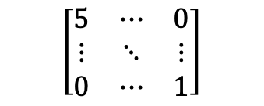
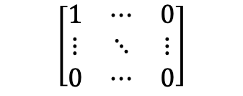
ATAC pseudo bulk
10x peak count x cell matrix
Peaks
Pseudo bulk by time + cell type
Peaks
Cells from all time points
$$\left[\begin{matrix}1 & ⋯ & 0 \\ ⋮ & ⋱ & ⋮ \\ 0 & ⋯ & 0\end{matrix}\right]$$
$$\left[\begin{matrix}5 & ⋯ & 0 \\ ⋮ & ⋱ & ⋮ \\ 0 & ⋯ & 1\end{matrix}\right]$$
Normalization to account for cell number ?
Pseudo bulk ATAC read count
-> discrete

Slide 2
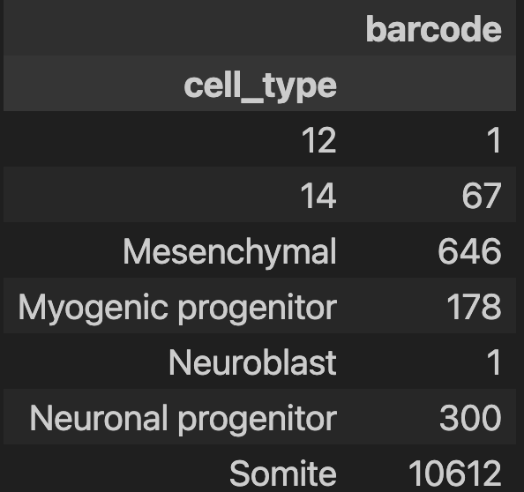
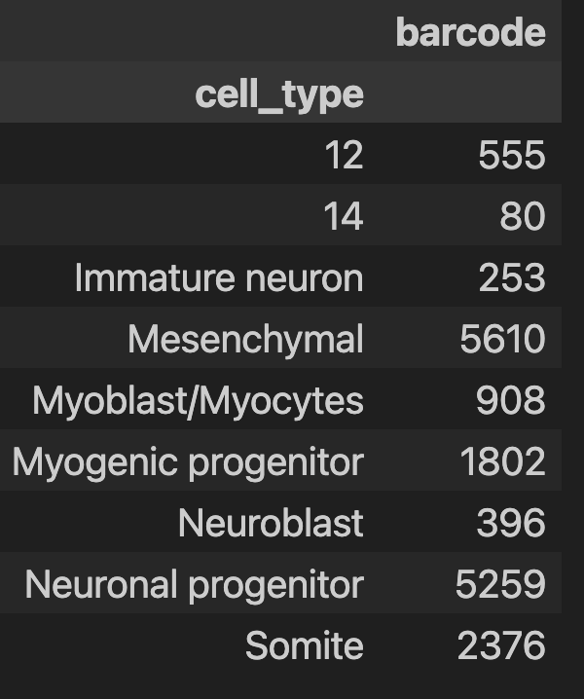
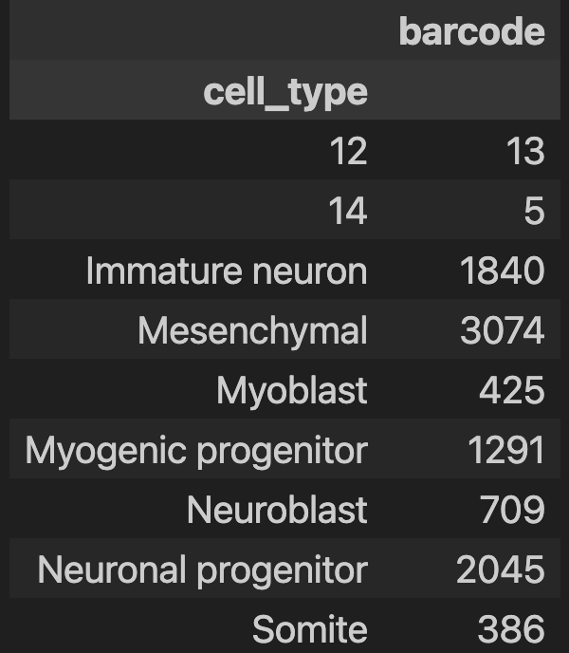
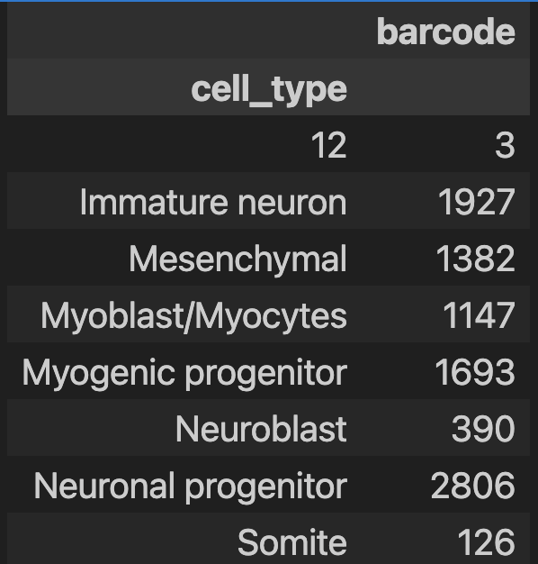
Aggregate for some time + cell type -> very few cells. Do still keep those pseudo bulk? Probably not enough cells to be good estimate of tracks
Day8_1
Day12_1
Day20_1
Day22_1

Slide 3

Extract sequence from peak
Reference genome: hg38
For each peak
Get sequence on reference genome
One hot encode it
A G T
$$\begin{matrix}1 & 0 & 1 \\ 0 & 0 & 0 \\ \begin{aligned}0 \\ 0\end{aligned} & \begin{aligned}1 \\ 0\end{aligned} & \begin{aligned}0 \\ 0\end{aligned}\end{matrix}$$
Chr 10: 902758- 902820
Keep sex chromosomes
Which sequence do we use?
Exact length around center peak or max ?
What to do with the N in the sequences? Remove them
Sequence should have fixed length!
Use all peaks for sequence + add GC content matched background regions
Add GC matched non-peaks -> background regions

Slide 4
Get the countinous track with base resolution
Split BAM by cell type
Generate track .bw
Contruct bins of fixed length and compute number of reads in these bins.
10x output BAM file with ATAC fragment of all cells for each dataset
Base resolution?
Use sliding window of 200 bp on .bw to get base resolution ATAC signal

Slide 5
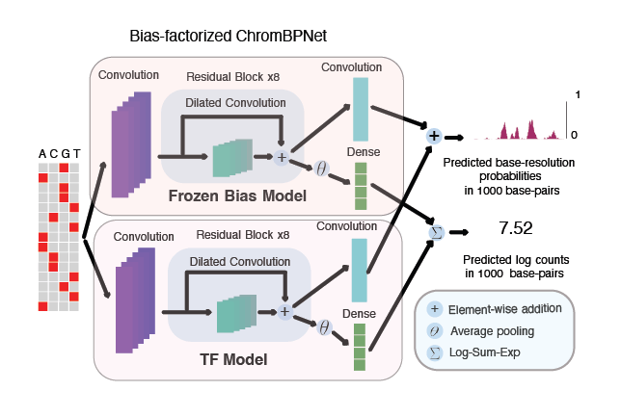
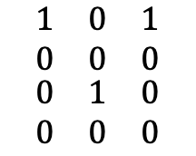
BPNet
Deconvolution
Convolutional layers
Profile prediction head: probability of Tn5 insertion at each position sequence
$$\begin{matrix}1 & 0 & 1 \\ 0 & 0 & 0 \\ \begin{aligned}0 \\ 0\end{aligned} & \begin{aligned}1 \\ 0\end{aligned} & \begin{aligned}0 \\ 0\end{aligned}\end{matrix}$$
Multiply total count by probability each base to get predicted at position
Total count prediction: total Tn5 insertion over input region
Sequence
Skipped connections + dilated
Global pool + linear layer
Should we go bigger (ie more parameters) since we need more capacity since modelling all cell types at once? Yes
How to handle such large datasets?
Make sure dtype as efficient as possible
Train/test split? Keep some chr for testing
Where would you add the metadata? After some convolutional layers
Notes:
https://github.com/kundajelab/chrombpnet

Slide 6
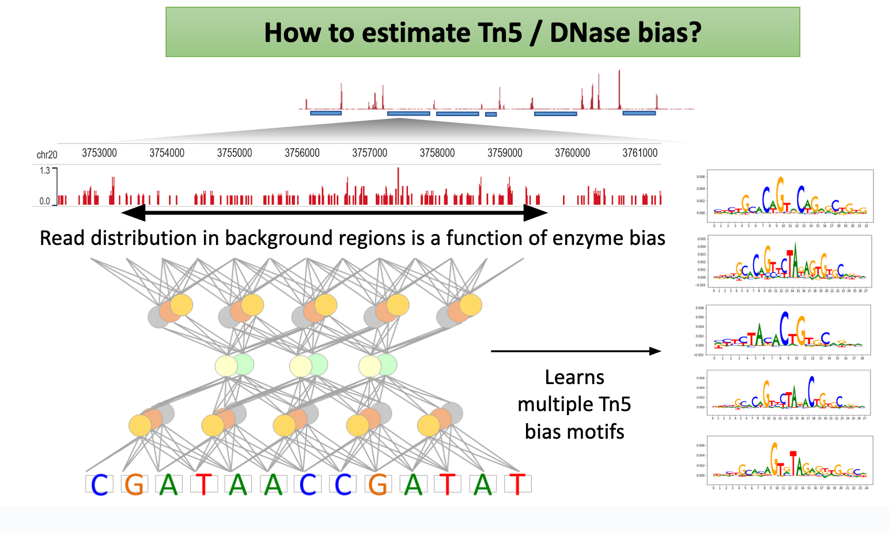
Bias correction
Notes:
https://github.com/kundajelab/chrombpnet

Slide 7
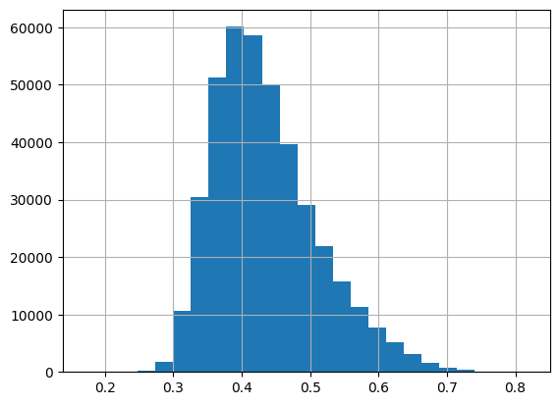
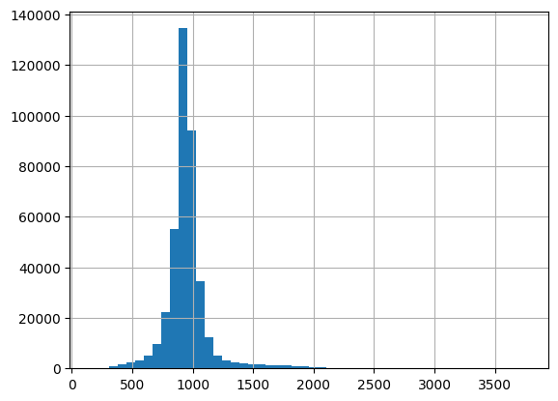
Distribution of GC content
Sequence N
-> 1027 sequences with N
-> Not that many discard them
Distribution of ATAC peak lengths
-> Median 939
Peak
N = 2114, predict for smaller sequence (1000)
-> Size + where to center (summit, middle peak)
Notes:
https://github.com/kundajelab/chrombpnet

Slide 8
Write BPNet architechture
Write model architechture
Write training/testing loop
Write function fetching the continous ATAC signal -> sliding window over the sequence
Go back to dataset class
Compute coverage/deapth

Slide 9
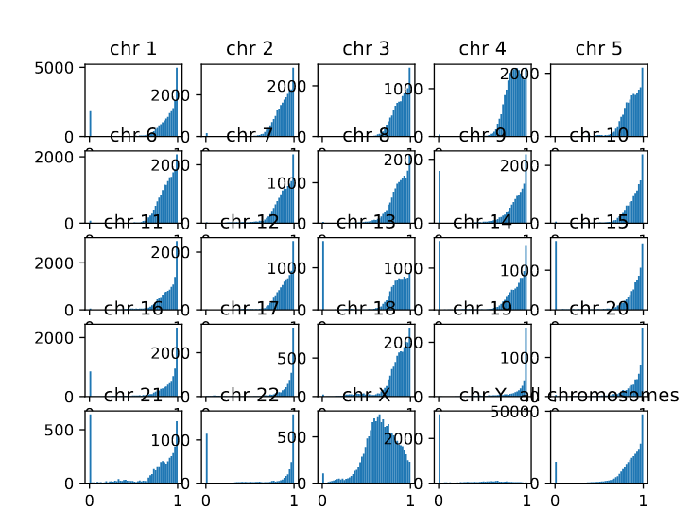
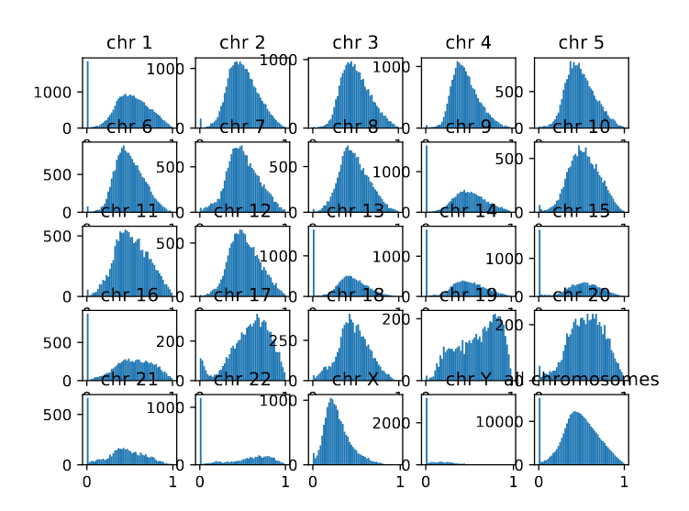
How much cells is enough for pseudo-bulk?
Coverage in 10’000 genome bins across genome
D12_1: Somite
D8_1: Somite

Slide 10
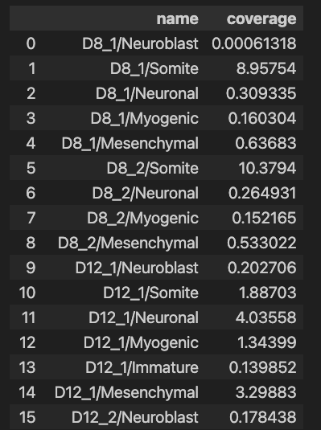
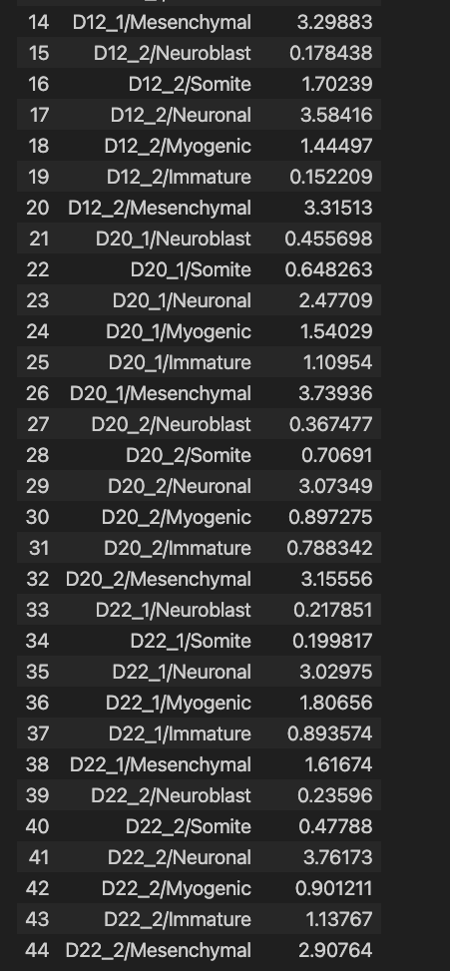
How much cells is enough for pseudo-bulk?
Average number of reads across all positions (depth)
D8_1: Somite

Slide 11
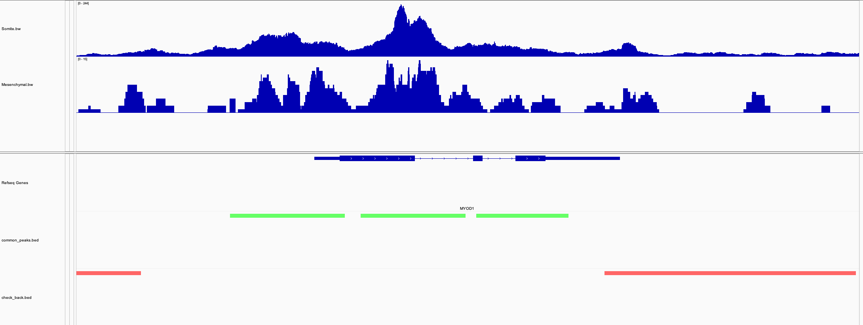
Define input sequences
D8_1
Peaks
Background

Slide 12
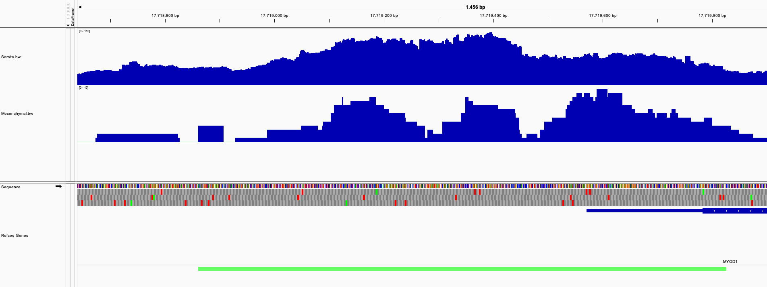
Define input sequences
Distribution of ATAC peak lengths
-> Median 939
We have the regions of interest how do we define the sequence?
How to center it? Middle region, max peak,…
Length of input sequence with context?
Length of sequence for which track predicted?

Slide 13
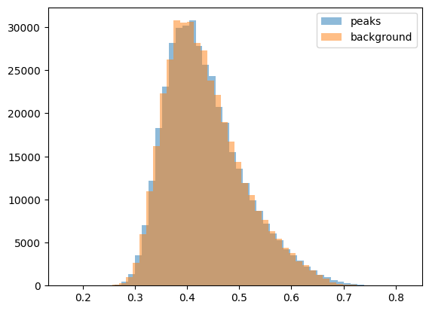
Define input sequences
GC content distributions
Almost all peak region is matched to a background region in term of GC content within 1% -> should we really use all of them for training the model or subsample? ChromBPNet subsample 10%

Slide 14
Get ATAC track for each pseudo-bulk at each peak and background region
Normalize by diving by total read counts in pseudo bulk *100’000
Sliding window of 200 bp

Slide 15
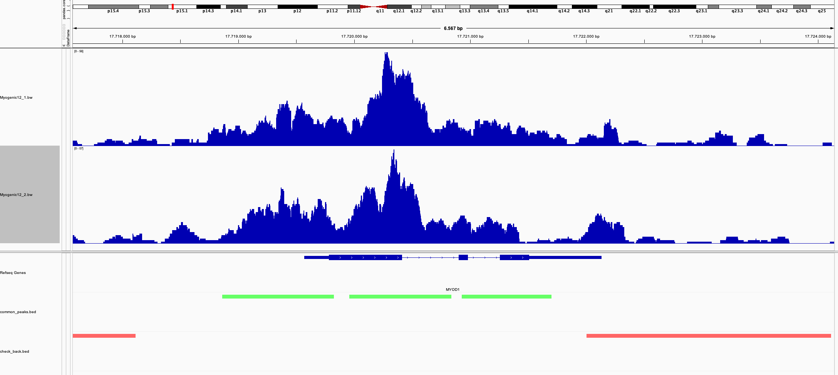
Fore same cell type + time point, we have two replicates -> encode replicates as same time points?

Slide 16
Training framework
“K-fold cross validation” -> create 5 split to train/validate/test on
ch1
Ch19,2
Split 20/20/60%
test
validation
training

Slide 17
Model
Convolutional layers
How to merge representation + encoded cell type?
Skipped connections + dilated
Sequence
$$\begin{matrix}1 & 0 & 1 \\ 0 & 0 & 0 \\ \begin{aligned}0 \\ 0\end{aligned} & \begin{aligned}1 \\ 0\end{aligned} & \begin{aligned}0 \\ 0\end{aligned}\end{matrix}$$
Dense layer or CNN here? Need covolution if we want to predic tATAC track as BPNet
Batch, seq-len,4
Batch, seq-len_crop, nb_filters
Cell type
Batch, nb_cell_type
Notes:
https://github.com/kundajelab/chrombpnet

Slide 18
Model
Convolution
Convolutional layers
Profile prediction head: probability of Tn5 insertion at each position sequence
$$\begin{matrix}1 & 0 & 1 \\ 0 & 0 & 0 \\ \begin{aligned}0 \\ 0\end{aligned} & \begin{aligned}1 \\ 0\end{aligned} & \begin{aligned}0 \\ 0\end{aligned}\end{matrix}$$
Multiply total count by probability each base to get predicted at position
Total count prediction: total Tn5 insertion over input region
Sequence
Skipped connections + dilated
Global pool + linear layer
Notes:
https://github.com/kundajelab/chrombpnet

Slide 19
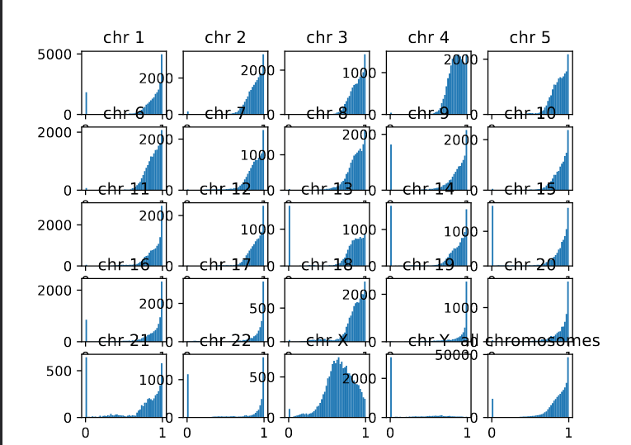
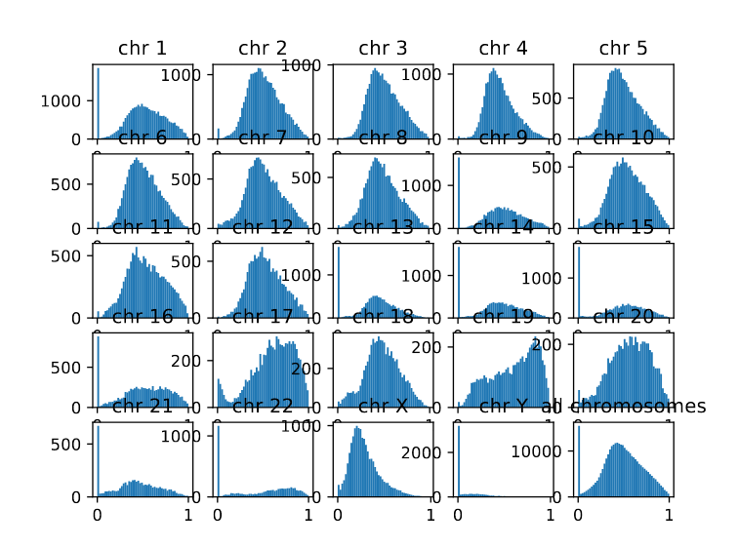

Subsample Somite D8_1
D8 Somite (n= 10612)
Subsamble D8 Somite (n= 2376)
D12 Somite (n= 2376)
Subsamble
Every pseudo-bulk has same number of cells
For each cell type, same number of cells across time point
Drop pseudo-bulk with too few cells. Check time course ATAC seq data litterature, how they account for coverage differerences
Notes:
We normalized the number of unique peaks in each cell for read depth by dividing by each cell’s cellranger-computed atac_peak_region_fragments metric so that we could compare the number of unique peaks along PT, LOH, and POD differentiation trajectories in day 26 organoid and human adult kidney datasets.
https://www.ncbi.nlm.nih.gov/pmc/articles/PMC10193973/

